Slide 1
Chapter Six-Software Security

Slide 2
Overview
  Software security is the idea of engineering software so that it continues to function correctly under malicious attack.
  A central and critical aspect of the computer security problem is a software problem.
  Software security is an idea implemented to protect software against malicious attack and other hacker risks so that the software continues to function correctly under such potential risks.
  Security is necessary to provide integrity, authentication and availability.

Slide 3
Software Security Threats
  Any compromise to integrity, authentication and availability makes a software unsecure.
  Software systems can be attacked to steal information, monitor content, introduce vulnerabilities and damage the behavior of software.
  Malware can cause DoS (denial of service) or crash the system itself.
  Software defects with security ramifications including :
    implementation bugs such as buffer overflows and
    design flaws such as inconsistent error handling.

Slide 4
Software Security Threats
  Any compromise to integrity, authentication and availability makes a software unsecure.
  Buffer overflow, stack overflow, command injection and SQL injections are the most common attacks on the software.
  Buffer and stack overflow attacks overwrite the contents of the heap or stack respectively by writing extra bytes.

Slide 5
Software Security Threats
  Command injection can be achieved on the software code when system commands are used predominantly.
  New system commands are appended to existing commands by the malicious attack.
  Sometimes system command may stop services and cause DoS.
  SQL injections use malicious SQL code to retrieve or modify important information from database servers.
  SQL injections can be used to bypass login credentials.
  Sometimes SQL injections fetch important information from a database or delete all important data from a database.

Slide 6
Software Security Threats
Malicious intruders can hack into systems by exploiting software defects
Software security includes:
  software design principles including the principles of
    least privilege,
    fail-safe stance, and
    defence-in-depth (These also included in Computer Security)
Internet-enabled software applications present the most common security risk encountered today, with software’s ever-expanding complexity and extensibility adding further fuel to the fire.

Slide 7
Software Security Threats
Software security best practices leverage good software engineering practice and involve thinking about security early in the software development lifecycle,
Knowing and understanding common threats including:
  Language-based flaws and pitfalls
  Designing for security and subjecting all software artefacts to thorough objective risk analyses and testing.

Slide 8
Software Security Threats
The only way to avoid such attacks is to practice good programming techniques.
System-level security can be provided using better firewalls.
Using intrusion detection and prevention can also aid in stopping attackers from easy access to the system.

Slide 9
Application Security Vs Software Security
Software security is about building secure software:
  designing software to be secure,
  making sure that software is secure and educating software developers, architects and users about how to build secure things.
Application security is about protecting software and the systems that software runs in a post facto way, after development is complete.

Slide 10
Application Security Vs Software Security
Application security follows naturally from a network-centric approach to security,
  by embracing standard approaches such as penetrate and patch
  Input filtering (trying to block malicious input)
  by providing value in a reactive way.
Application security is based primarily on finding and fixing known security problems after they’ve been exploited in fielded systems.

Slide 11
Application Security Vs Software Security
Software security is the process of designing, building and testing software for security
  Identifies and expunges problems in the software itself.
In this way, software security practitioners attempt to build software that can withstand attack proactively.
  Example: although there is some real value in stopping buffer overflow attacks by observing HTTP traffic as it arrives over port 80, a superior approach is to fix the broken code and avoid the buffer overflow completely.

Slide 12
Application Security Vs Software Security
Issues critical to this subfield include:
  sandboxing code (as the Java virtual machine does),
  protecting against malicious code,
  obfuscating code,
  locking down executables,
  monitoring programs as they run (especially their input),
  enforcing the software use policy with technology and dealing with extensible systems.

Slide 13
Application Security Vs Software Security
Application security technologies such as firewalls have evolved the way they have is because operations people dreamed them up.
In most corporations and large organizations, security is the domain of the infrastructure people who set up and maintain firewalls, intrusion detection systems, and antivirus engines
(all of which are reactive technologies).

Slide 14
Application Security Vs Software Security
Must make progress on both fronts.
But in the long run, software engineers must figure out ways to build easier-to-defend code.
Software security is about helping builders do a better job so that operators end up with an easier job.
Software security is a system-wide issue that takes into account both security mechanisms (such as access control) and design for security (such as robust design that makes software attacks difficult).

Slide 15
Software Security in Software Development life Cycle
Security is an emergent property of a software system.
A security problem is more likely to arise because of a problem in a standard-issue part of the system ( the interface and access control to the database module) than in some given security feature.
This is an important reason why software security must be part of a full life cycle approach.
As software engineers become aware of software security’s importance, they are increasingly adopting and evolving a set of best practices to address the problem.

Slide 16
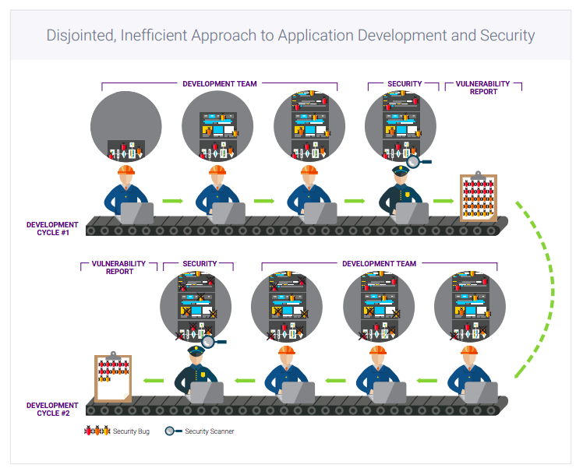
Software Security in Software Development life Cycle

Slide 17
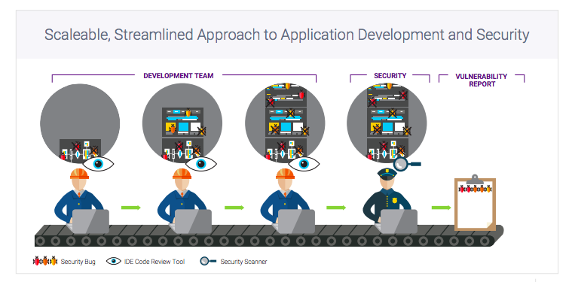
Software Security in Software Development life Cycle

Slide 18
Software Security in Software Development life Cycle
In Application development, the cost of finding and remediating any defect is dramatically reduced when the defect is found early in the development lifecycle the earlier the better.
Finding and fixing security vulnerabilities is a vital and necessary part of the software development process.
However, the trial-and-error approach to scanning and remediating code adds a significant amount of time to the development process, which risks delaying the delivery of product upgrades and enhancements eroding the organization’s competitiveness and threatening revenue.

Slide 19
Software Security in Software Development life Cycle
Application scanning remains a critical tool in ensuring the security of those applications.
Unfortunately, because application scanning occurs so late in the development lifecycle, security defects aren’t discovered until they’re very expensive and time-consuming to fix.
Even the costs of hardware, software, and personnel required can be staggering: organizations with comparatively modest application portfolios easily spend millions of dollars per year.

Slide 20
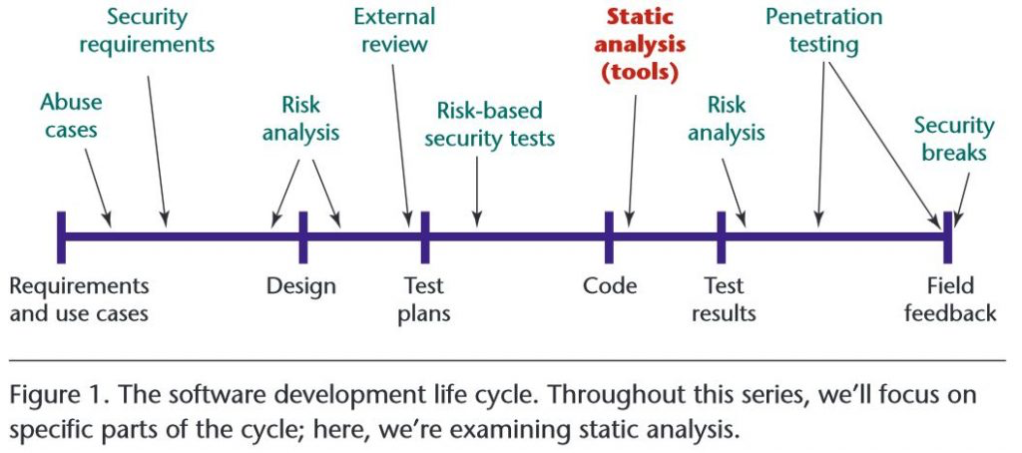
Software Security in Software Development life Cycle

Slide 21
Software Security in Software Development life Cycle
Security should be explicitly at the requirements level.
Security requirements must cover both overt functional security (say, the use of applied cryptography) and emergent characteristics.
One great way to cover the emergent security space is to build abuse cases.
Similar to use cases, abuse cases describe the system’s behavior under attack; building them requires explicit coverage of what should be protected, from whom, and for how long.

Slide 22
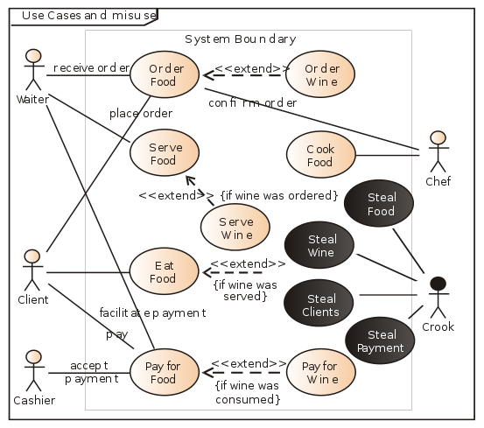

Slide 23
Software Security in Software Development life Cycle
At the design and architecture level, a system must be coherent and present a unified security architecture that takes into account security principles (such as the principle of least privilege).
Designers, architects, and analysts must clearly document assumptions and identify possible attacks.
At both the specifications-based architecture stage and at the class-hierarchy design stage, risk analysis is a necessity security analysts should uncover and rank risks so that mitigation can begin.
Disregarding risk analysis at this level will lead to costly problems down the road. External review (outside the design team) is often necessary.

Slide 24
Software Security in Software Development life Cycle
At the code level, we should focus on implementation flaws, especially those that static analysis tools (Synopsis Statistic Analysis) tools that scan source code for common vulnerabilities and can discover.
Several vendors now address this space, and tools should see market-driven improvement and rapid maturity later this year.
Code review is a necessary, but not sufficient, practice for achieving secure software.
Security bugs (especially in C and C++) can be deadly, but architectural flaws are just as big a problem.
Bugs and flaws divide the software security defect space 50/50

Slide 25
Software Security in Software Development life Cycle
Bugs
  Bugs are found in software code (source or binary).
  One of the classic bugs of all time, the buffer overflow, has at its root the misuse of certain string handling functions in C.
  The most notorious such functions is gets() -- a system call that gets input from a user until the user decides to hit return.
  In the case of a buffer overflow in C, too much input can overwrite the heap or even overwrite the stack in such a way as to take control of the process. Simple bug. Awful repercussions. (And in the case of gets(), particularly easy to find in source code.)

Slide 26
Software Security in Software Development life Cycle
Hundreds of system calls exist in all programming languages that can lead to security bugs if they are used incorrectly, ranging from string handling functions to integer overflow and integer underflow hazards.
There are just as many bugs in Java and other languages.
There are also common bugs in Web applications ( cross-site scripting or cross-site request forgery) and bugs related to databases (like SQL injection).

Slide 27
Software Security in Software Development life Cycle
Many commercial source code review tools available include HP's Fortify, IBM AppScan Source, Coverity Inc.'s Quality Advisor, and Klocwork Inc.'s Clocwork Insight.
The latest twist in source code review is to integrate bug finding directly into each developer's integrated development environment (IDE), so that bugs are uncovered as close to conception as possible.
For example, Cigital Inc.'s SecureAssist does this.

Slide 28
Software Security in Software Development life Cycle
Flaws
  At the other end of the defect spectrum we find flaws. Flaws are found in software architecture and design.
  Here's a really simple flaw example. For example, Forgot to authenticate user.
  This kind of error of omission will usually not be found with code review. But it can be a serious problem. Does your process run as root? Better be darn sure who's using it!
  Other examples of flaws include "attacker in the middle" problems that allow tampering or eavesdropping between components, layers, machines, or networks; and "replay attack" problems that have to do with weak protocols.

Slide 29
Software Security in Software Development life Cycle
A list of some common Java-related flaws:
  misuse of cryptography,
  compartmentalization problems in design,
  privileged block protection failure (DoPrivilege()),
  catastrophic security failure (fragility),
  type safety confusion error,
  insecure auditing,
  broken or illogical access control,
  method over-riding problems (subclass issues),
  too much trust in (client-side) components that should not be trusted.
  (For more on these issues, see McGraw's ancient book Securing Java.)

Slide 30
Software Security in Software Development life Cycle
Security testing must encompass two strategies:
  Testing security functionality with standard functional testing techniques,
  Risk-based security testing based on attack patterns and threat models.
  A good security test plan (with traceability back to requirements) uses both strategies.
  Security problems aren’t always apparent, even when software engineers probe a system directly, so standard-issue quality assurance is unlikely to uncover all the pressing security issues.

Slide 31
Software Security in Software Development life Cycle
Penetration testing is also useful, especially if an architectural risk analysis is specifically driving the tests.
The advantage of penetration testing is that it gives a good understanding of fielded software in its real environment.
However, any black box penetration testing that doesn’t take the software architecture into account probably won’t uncover anything deeply interesting about software risk.

Slide 32
Software Security in Software Development life Cycle
Software that falls prey to canned black box testing: which simplistic application security testing tools on the market today practice is truly bad.
This means that passing a cursory penetration test reveals very little about your real security posture, but failing an easy canned penetration test tells you that you’re in very deep trouble indeed.

Slide 33
Software Security in Software Development life Cycle
Operations people should carefully monitor fielded systems during use for security breaks.
Simply put, attacks will happen, regardless of the strength of design and implementation, so monitoring software behavior is an excellent defensive technique.

Slide 34
Software Security in Software Development life Cycle
Knowledge gained by understanding attacks and exploits should be cycled back into the development organization, and security practitioners should explicitly track both threat models and attack patterns.
Note that risks crop up during all stages of the software life cycle, so a constant risk analysis thread, with recurring risk tracking and monitoring activities, is highly recommended.

Slide 35
Software Security in Software Development life Cycle
Software security can and should borrow from other disciplines in computer science and software engineering when developing and evolving best practices. Of particular relevance are:
  Security requirements engineering,
  Design for security, software architecture and architectural analysis,
  Security analysis, security testing, and use of the Common Criteria,

Slide 36
Software Security in Software Development life Cycle
  Guiding principles for software security and case studies in design and analysis
  Auditing software for implementation risks, architectural risks, automated tools and technology developments (code scanning, information flow and so on), and
  Common implementation risks (buffer overflows, race conditions, randomness, authentication systems, access control, applied cryptography and trust management).

Slide 37
Software Security in Software Development life Cycle
As the trinity of trouble—connectedness, complexity and extensibility continues to impact software security in a negative way
Integrating a decent set of best practices into the software development life cycle is an excellent way to do this.
Although software security as a field has much maturing to do

Slide 38
Finding Flaws with ARA (Architecture Risk Analysis)
ARA is a four-step process
Step 0 (naturally start with 0 since you're geeks) is get an architecture diagram.
A relevant and up-to-date architecture diagram out of the development team is sometimes harder than it should be.
For example, some extreme Agile methods say things like "the code is the design." I beg to differ.

Slide 39
Finding Flaws with ARA
The ultimate goal for this step is to create a one-page diagram of the software system.
One page is important, because software engineers want a forest-level view of the software.
Bugs are found at the tree level, flaws at the forest level.
We don't want reams of code, we don't want UML and we don't want a firewall placement network map.
In many cases, we build the one-page diagram ourselves through a process of interviewing software architects, developers and testers.

Slide 40
Finding Flaws with ARA
Your diagram will have some essential components including:
  but not limited to DAO/persistence layers,
  business logic/business rules,
  security features,
  toolkits (WSE, WCF, Ajax),
  middleware,
  Web services, cloud API, caching and distribution.

Slide 41
Finding Flaws with ARA
There are three specialized analysis steps in an ARA:
  1) known-attack analysis,
  2) system-specific attack analysis, and
  3) dependency analysis.

Slide 42
Finding Flaws with ARA
1) Known attack analysis is about as straightforward as it gets.
  Take a list of known attacks relevant to your architecture and go through them.
  Example: Microsoft's STRIDE approach (part of what they mistakenly call threat modeling) is a good example.
  STRIDE is an acronym for spoofing, tampering, repudiation, information disclosure, denial of service, and elevation of privilege.

Slide 43
Finding Flaws with ARA
The key to known attack analysis is to know some attacks.
One way to create such a list is to ask your vulnerability management group which attacks are consistently being uncovered.
When you find an attack on your list that's relevant, calculate its impact and think about how you would fix the architecture to mitigate the risk.
Sometimes a defect does not need to be entirely solved or completely eradicated. It just need to reduce the risk to an acceptable level for a given set of conditions.

Slide 44
Finding Flaws with ARA
2) System-specific attack analysis focuses on exposing invalid assumptions, ferreting out ambiguity and finding new attacks based on how the system works.
This step requires the most hard-core experience and natural ability because security itself is an emergent property of software.
Sometimes a piece of software seems to behave properly when it's all by itself, but when it's added to a bigger ecosystem it goes entirely off the rails? That's partially what it means.
Anticipating emergent consequences can be tricky business.

Slide 45
Finding Flaws with ARA
In any case, decomposing the problem can be helpful.
At the very least, during this step a software designer should think about trust modeling
  (identifying trust boundaries explicitly),
  data sensitivity modeling (identifying privacy and trust issues) and
  threat modeling (identifying attackers and considering the attacker's perspective).

Slide 46
Finding Flaws with ARA
3) Dependency analysis has to do with determining how wobbly the tower of other software your counting on to work turns out to be.
Today's software almost always relies on the proper behavior of components and frameworks that someone else designed and built.
  What were their assumptions, and
  How do they impact your system?
  What will happen to your design if the frameworks misbehave?

Slide 47
Finding Flaws with ARA
Start with the components you're relying on.
  Are there known vulnerabilities in the components you're counting on? (Open source or otherwise, the answer is often "yes.")
  Do you have sufficient security controls built into the framework? Do they actually work? (Sadly, the answer is "no" more often than we would like.)
  Are there features or functions that need to be disabled? (Probably.)
  Is the framework secure by default? (Maybe, if you have been very good lately.)
Write down what you find. Think through impact. Determine what to do about it.

Slide 48
Finding Flaws with ARA
After completing the above four steps to ARA, you'll find yourself with a bunch of risks and some ideas for improving the design.
Take those risks and explicitly consider business impact.
Then rank your findings, organize them and propose a solution to the most important flaws you've uncovered.

Slide 49
Lightweight design review
The process of ARA is intense and the work is high-expertise, an in-depth ARA will not make sense for all of the applications you have in your portfolio.
ARA is a must-have for critical systems, but not so much for systems that are not the core of your business.
In a future article, software engineers to tackle what can be done to address the flaws in these "lesser" systems.

Slide 50
Fix your flaws
Whether your architecture review process leads to quick refactorings or multi-year enterprise architecture changes over multiple releases, today is the time to focus real attention on software security flaws.
Software engineers can't abandon the bug parade and the tools they use to find and fix bugs, but because flaws make up about half the problem, it's only prudent to address them.

Slide 51
OWASP
In the Application Security space, one of those groups is the Open Web Application Security Project (or OWASP for short).
The Open Web Application Security Project (OWASP) is a worldwide not-for-profit charitable organization focused on improving the security of software.
Their mission is to make software security visible, so that individuals and organizations are able to make informed decisions.
OWASP is in a unique position to provide impartial, practical information about AppSec to anyone.
Operating as a community of like-minded professionals, OWASP issues software tools and knowledge-based documentation on application security.

